Slide 1




NEXT GEN EMPLOYABILITY PROGRAM
Creating a future-ready workforce
Student Details
College Name
Student Name :ABINOW K K
Student ID : au513521104001
Annai Mira College of Engineering and Technology
Notes:
1

Slide 2

CAPSTONE PROJECT SHOWCASE
Project Title
Building Bus Reservation System using Python and Django
Abstract | Problem Statement | Project Overview | Proposed Solution | Technology Used | Modelling & Results | Conclusion

Slide 3
Abstract
Purpose:The purpose of an Online Bus Reservation System is to provide a convenient and efficient platform for users to book bus tickets online, saving time and improving the overall booking experience..
Features: The system will include features such as user authentication, bus management (including routes, schedules, and availability), a reservation system with seat selection and also cancelling the booked buses.
Technology Stack: Built using Python and the Django web framework, the project utilizes Django’s built-in authentication system for user management, and integration with third-party payment gateways for secure transactions.
Objective:The objectives of an online bus reservation system revolve around enhancing user experience, optimizing operational efficiency, and driving business growth. Firstly, the system aims to provide users with a convenient and accessible platform for booking bus tickets from anywhere at any time, eliminating the constraints of physical visits to booking offices.
Source :

Slide 4
Problem Statement
The implementation of an online bus reservation system seeks to address several key challenges faced by both users and bus operators in the traditional booking process. Currently, users often encounter inconvenience and time constraints when attempting to book bus tickets, having to physically visit booking offices or rely on third-party agents. Limited accessibility to up-to-date information on seat availability, schedules, and fares further complicates the booking experience. Additionally, bus operators struggle with inefficient resource management, leading to suboptimal utilization of buses, routes, and schedules, resulting in increased operational costs. Customer satisfaction is also at risk due to inconsistent service quality and lack of reliable support channels. Moreover, concerns about data security and privacy deter users from fully embracing online booking platforms.
Source :

Slide 5
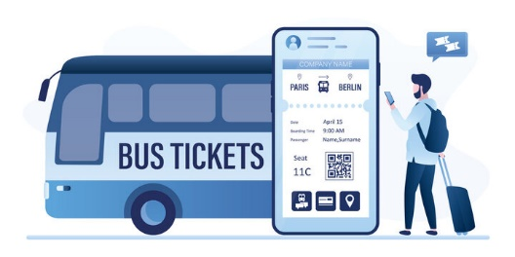
Project Overview
Booking Buses Made Easy: We're creating a website where you can easily find and book bus tickets online. No more standing in long lines or struggling with confusing websites. Just a few clicks, and you're all set for your journey!
Hassle-Free Travel Planning: Our platform will let you check bus routes, pick your seats, and pay securely online. Say goodbye to last-minute worries about finding a seat or missing out on your preferred bus – we've got you covered!
Convenient for Bus Operators Too: Bus operators will have an easy time managing their services with our system. They can update schedules, track bookings, and keep everything running smoothly, making travel hassle-free for everyone involved.
Source :

Slide 6
Proposed Solution
User Interface Design:
Develop an intuitive and user-friendly interface for the online bus reservation system.
Ensure easy navigation and seamless user experience across devices.
Search and Booking Functionality:
Implement a robust search engine allowing users to search for buses based on various parameters such as date, time, origin, and destination.
Enable users to select seats and book tickets securely with real-time updates on seat availability.
Real-time Updates and Notifications:
Provide real-time updates on bus schedules, seat availability, booking confirmations, and reminders through email/SMS notifications.
Keep users informed about any changes or disruptions in their travel plans.
:

Slide 7
Bus Management Dashboard:
Provide bus operators with a dedicated dashboard to manage their services. This dashboard will allow operators to add new buses, update routes and schedules, manage seat availability, and track bookings in real-time.
Dynamic Seat Selection:
Implement a dynamic seat selection feature that allows users to view and select available seats on the bus. Users should be able to see which seats are already booked and choose their preferred seating arrangement.
Real-Time Availability Updates:
Ensure that seat availability information is updated in real-time to provide users with accurate and up-to-date information. This will prevent overbooking and reduce the likelihood of conflicts during the reservation process.
Secure Payment Integration:
Integrate a secure payment gateway to facilitate online transactions for bus reservations. Users should be able to pay using various payment methods, such as credit/debit cards, mobile wallets, or net banking, with confidence in the security of their personal and financial informatio
Source :

Slide 8
Email Notifications:
Set up automated email notifications to confirm bookings, provide booking details, and send reminders about upcoming trips. These notifications will enhance the user experience and keep users informed throughout the reservation process.
Feedback and Support:
Include features for users to provide feedback on their booking experience and seek support in case of any issues or concerns. This will help in continuously improving the platform and addressing any customer inquiries promptly.
Scalability and Performance:
Design the system with scalability and performance in mind to handle a large number of concurrent users and accommodate future growth. Utilize caching mechanisms, optimize database queries, and employ scalable infrastructure to ensure smooth operation even during peak usage periods.
.
Source :

Slide 9


Technology Used
Front-end
Back-end
Source :

Slide 10
Modelling & Results
MODELLING:
Database Modeling:
Utilize Django's ORM to design and implement the database schema for the project. Define models for buses, routes, schedules, reservations, users, and any other relevant entities. Establish appropriate relationships between these models (such as one-to-many or many-to-many) to accurately represent the data structure.
User Interaction Modeling:
Model the user interaction flow through wireframes or mockups to visualize the user interface design. Consider the user journey from searching for bus routes to making a reservation and receiving confirmation. Iterate on the designs based on usability testing and feedback to optimize the user experience.
RESULTS:
User satisfaction on using our website .
Easier way of booking the tickets in the easier and in the efficient way

Slide 11
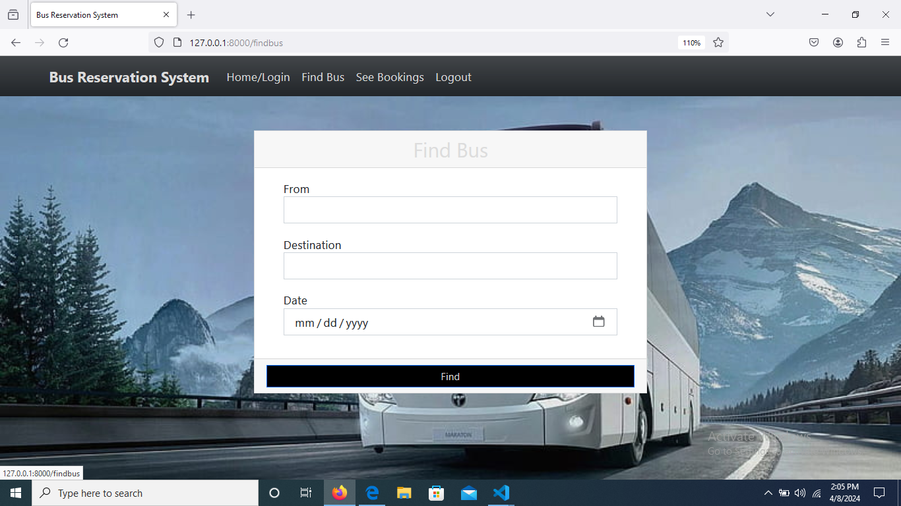
Homepage
The Home page consists of a friendly interface and easier navigation to all the pages like Find Bus, See Bookings and Registration pages .
It provides easy access so that all people can use the website without any issues

Slide 12
About-Us-Page
The About Us page contains the following informations.
Provide a brief overview of the company's history, including its founding date, key milestones, and the vision that drives its operations. Communicate the company's mission statement and core values, outlining its commitment to providing convenient, reliable, and affordable bus travel solutions to customers.
Introduce the team behind the online bus reservation platform, including key members such as founders, developers, designers, and customer support representatives. Share brief bios or profiles of team members, highlighting their expertise, passion for innovation, and dedication to delivering exceptional service to users.
Showcase customer testimonials and success stories to demonstrate the positive impact of the platform on users' travel experiences. Highlight real-life examples of satisfied customers who have benefited from the convenience, ease of use, and reliability of the online bus reservation service. Include quotes, photos, or videos to add authenticity and credibility to the testimonials.

Slide 13
Service-Page
The sevices page contains the following informations
Booking Services: Provide detailed information about the booking services offered through the platform, including the types of bus tickets available (e.g., one-way, round-trip), reservation options (e.g., seat selection, flexible dates), and any special offers or discounts available to customers.
Customer Support Services: Outline the customer support services provided to assist users throughout their journey, such as 24/7 helpline assistance, live chat support, and email support. Highlight the responsiveness, professionalism, and expertise of the customer support team in addressing user inquiries, resolving issues, and ensuring a positive experience for customers.
Additional Value-Added Services: Showcase any additional value-added services offered to enhance the overall travel experience for customers, such as travel insurance options, shuttle services, or partner discounts on accommodations and activities. Emphasize the convenience, reliability, and affordability of these services in meeting the diverse needs and preferences of travelers.

Slide 14
Departments-Page
The departments page contains the following informations
Operational Departments Overview: Provide an overview of the operational departments within the organization, such as the booking department, customer service department, and technical support department. Explain the role and responsibilities of each department in ensuring the smooth operation of the online bus reservation platform.
Team Members and Roles: Highlight the team members associated with each department, along with their respective roles and areas of expertise. This could include department heads, managers, supervisors, and staff members responsible for executing day-to-day tasks and providing support to customers and stakeholders.
Collaboration and Communication Channels: Describe how different departments collaborate and communicate with each other to achieve common goals and deliver exceptional service to customers. Highlight the communication channels used, such as team meetings, project management tools, and internal messaging platforms, to facilitate seamless coordination and information sharing across departments.

Slide 15
Future Enhancements:
Mobile App Development: Consider developing a mobile app version of the online bus reservation platform to cater to users who prefer to book tickets and manage reservations on their smartphones or tablets. The app could offer additional features such as push notifications for booking updates, GPS tracking of buses in real-time, and seamless integration with mobile payment options for enhanced convenience and accessibility.
Advanced Analytics and Personalization: Implement advanced analytics and machine learning algorithms to analyze user behavior, preferences, and booking patterns. Use this data to personalize the user experience by offering targeted recommendations, customized promotions, and tailored travel suggestions based on individual preferences and past booking history. This could help increase user engagement, loyalty, and conversion rates on the platform.
Integration with Transportation Networks: Explore opportunities to integrate the online bus reservation platform with other transportation networks, such as railways, airlines, and ride-sharing services. This could enable users to seamlessly plan multi-modal journeys, book connecting tickets, and access integrated travel itineraries through a single platform.

Slide 16
Conclusion
In conclusion, the implementation of an online bus reservation system brings significant advantages to both bus operators and passengers alike. By leveraging technology to streamline booking processes, enhance convenience, and improve operational efficiency, the system contributes to a more seamless and enjoyable travel experience. For bus operators, it translates into increased revenue, cost savings, and better resource management, while passengers benefit from greater flexibility, accessibility, and customer satisfaction. Moreover, the system's ability to collect and analyze data provides valuable insights for optimizing services and staying competitive in the market. Overall, the online bus reservation system represents a transformative solution that not only meets the evolving needs of modern travelers but also drives growth and innovation in the transportation industry.
Source :

Slide 17
Thank You!
Notes:
Thank You !!

